Slide 1

CSE3505 – FOUNDATIONS OF DATA ANALYTICS
J – COMPONENT REVIEW ONE
PROJECT TITLE - ESTIMATION OF CITIZENS BELOW THE POVERTY LINE
TEAM E
Team Details – Our team contains of 4 members
NAME | REGISTER NUMBER
KHUSHI MATTU | 20BCE1189
UDITI GUPTA | 20BCE1445
ANSH GOEL | 20BCE1798
JESMINE AKHTER | 20BCE1945

Slide 2
PROBLEM STATEMENT
Poverty is one of the major obstacles that is hindering our country’s progress in today’s times. But to help the people who are stuck in the vicious cycle of poverty, one has to first categorize whether a person lives in poverty or not. Although the government has tried to elevate this situation by providing numerous social programs, most of the time these programs are not of great help as they are not able to correctly determine the target audience. Through our project we plan to classify people into various levels of poverty.

Slide 3
LITERATURE SURVEY

Slide 4
S. No. | Title | Journal/year of publication | Data set used | Methodologies used | Metrics used | Interpretation of Results
1 | Poverty Level characterization via feature selection and machine learning | IEEE, 2019 | Costa Rican Household data provided by Inter-American Development Bank : 143 predictors 9557 observations 4 target class Costa Rican Household Poverty Level Prediction | Kaggle | Data Preprocessing: Missing value interpolation Binarization: transforming 4-class problem into 4 different binary problems SMOTE to tackle class imbalance due “non-vulnerable” class Finding discrete subset of features for each class using Wrapper feature selector (Step forward feature selector) LIME (Local Interpretable Model-agonistic Explanations) model explanation technique to understand how these features trigger poverty Prediction Algorithms Used: Random Forest | F1 macro score | Emphasizes on understanding the features that most affect each target class. The proposed model fails to identify a fair decision boundary between the less populated classes: “Extreme”, “Moderate”, “Vulnerable”

Slide 5
2 | A clustering approach to identify multidimensional poverty indicators for the bottom 40 percent group | PLoS ONE August 2, 2021 | Data collected by the Malaysian Department of Statistics (DOSM), from the Malaysian Population and Housing Census 2010, consisting of 532,298 households | For clustering, K-Means algorithm was tested with four different distance measure: Euclidean Distance, Correlation Similarity, Cosine Similarity, Dice Similarity (DS) to choose the best distance measure. Determining the best k value: A series of analysis was performed by looking at the cluster size, centroid chart, scatter plot analysis, heat map analysis, and descriptive statistics method to investigate the pattern of each cluster formed further. | The Davies Bouldin metric measures the variation between points within the cluster and the distance between clusters. In each cluster, this metric determines which other group has the highest ratio between the average intracluster distance of points in two clusters to the distance between. Average within Centroid Distance metric is measured by calculating the average distance per point from a centroid point within a cluster. Sum of squares metric divides the number of data points in a group by the number of data points in each cluster. This is called squared, and the values of all the clusters are summed. | Cosine Similarity > Euclidean Distance > Correlation Similarity > Dice Similarity It is shown that the Cosine Similarity is the best distance technique based on the lowest score obtained. A clustering model-based K-Means Algorithm with Cosine Similarity measure is developed to form clusters of B40 group. The evaluation found k = 8 to be the best k value for the model. By employing the descriptive statistics method, three dimensions have been established: Education, Living Standards and Employment with seven indicators: literacy, highest education level and grade, sanitation, housing, access to television services, assets and work.

Slide 6
3 | Costa Rican Poverty Level Prediction | IETI Transactions on Social Sciences and Humanities, 2020 | Costa Rican Household data provided by Inter-American Development Bank : 143 predictors 9557 observations 4 target class Costa Rican Household Poverty Level Prediction | Kaggle | Data Preprocessing: Replacing missing value with mode of the column or zero - Replacing ‘yes’ and ‘no’ values with 0 and 1 Dividing the columns into categories: ID, Individual, Household, Squared - Dropping Squared columns Grouping the houses into positive and negative according to presence or absence of amenities Prediction Algorithms Used: K-Means Clustering Decision Tree Multinomial Logistic Regression Gradient Boosting | Accuracy Score for the ensemble model, Residual Deviance and AIC(Akaike Information Criteria) for Multinomial logistic regression | Variable Importance Plot generated to discover the effective predictors. Accuracy of the model is about 92.64% observed for the validation set. The proposed model works well for the training set but needs to be tested on the testing set provided

Slide 7
OBJECTIVE
Through our project, we aim to provide a better classification method for the above stated problem, which takes into consideration the number of family members, gender of family members, age of family members, number of rooms in the house, presence of sanitation facility, years of schooling, etc. After understanding the data, we will build a prediction model to perform classification to segregate households into Extreme poverty households, Moderate poverty households, Vulnerable households and Non-vulnerable households.

Slide 8
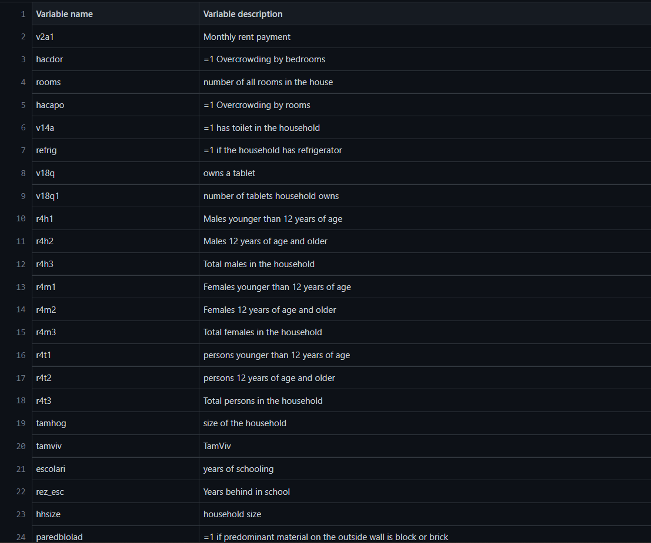
DATASET

Slide 9
ALGORITHMS TO BE USED
Random Forest
KNN Classification
Naive Bayes Classification
Gradient Boosting

Slide 10
NOVELTY/FINDINGS
We will have categorised the citizens into various groups, based on their incomes
After the completion of our analysis, we will be able to tell which classification method is best suited for categorising the citizens on the basis of the poverty line
We will also be able to ascertain which feature set works better- the VIM Feature set or the Correlation Feature Set

Slide 11
CONCLUSION
At the conclusion of our project, we will be able to determine how each model's accuracy varies according to the feature set. We will also be able to draw the conclusion that each model used in the VIM feature set has greater accuracy than the Correlation Feature set.

Slide 12
TIMELINE CHART
REVIEW ONE – 25TH AUGUST, 2022
REVIEW TWO – 29th AUGUST,2022
REVIEW THREE – 6th OCTOBER,2022

Slide 13
REFERENCES
www.sciencedirect.com
www.Wikipedia.com
https://sci-hub.se/
https://ieeexplore.ieee.org

